Slide 1
Time Frequency Analysis On PQD Using Advanced Signal Processing Techniques
Varshitha Thilak Kumar-CB.SC.U4AIE23258
Siri Sanjana S-CB.SC.U4AIE23249
Shreya Arun-CB.SC.U4AIE23253
Anagha Menon-CB.SC.U4AIE23212

Slide 2
Introduction
The need for clean, high-quality power has increased globally over the past decades.
Generated power is considered as pure sinusoidal waveform.
Deviation from this sinusoidal waveform at the nominal voltage level is considered as Power Quality Disturbance (PQD)
Causes voltage or frequency deviations in the power supply.
Results in equipment failure or malfunction of power grid.

Slide 3
Introduction
Signals are representations of physical quantities that vary with time, space, or any other independent variable.
Signal processing is the manipulation, analysis, and interpretation of signals.
üinvolves various techniques to extract information from signals,
üenhance their quality,
ücompress them for storage or transmission
üdetect patterns within them.
• Time-frequency analysis - study how the frequency content of a signal changes over time.

Slide 4
Literature Review
S. No | Title | Year | Content
[1] | THE FOURIER-BASED SYNCHROSQUEEZING TRANSFORM | 2014 | post-processing method which circumvents the uncertainty relation inherent to these linear transforms reassigning the coefficients in scale or frequency.
[2] | Time-Frequency Analysis of Non-Stationary Waveforms in Power-Quality via Synchro-squeezing Transform | 2017 | SST , very much effective in characterization of PQ events
[3] | A Generalized Classification Framework for Power Quality Disturbances Based on Synchro-squeezed Wavelet Transform and Convolutional Neural Networks | 2023 | SWT is utilized to transform the signals into time-frequency matrices. The obtained time-frequency representations have been compared with STFT and pseudo wigner ville distribution.

Slide 5
Literature Review
S. No | Title | Year | Content
[4] | The Huang Hilbert Transform for evaluating the instantaneous frequency evolution of transient signals in non-linear systems | 2016 | HHT- the current flowing in an actual RLC circuit during its free natural oscillation has been analyzed. RLC circuit during its free natural oscillation has been analyzed.
[5] | Synchro-squeezing-based time-frequency analysis of multivariate data | 2015 | In this article, SST is used to analyze multivariate data by introducing a multivariate extension of the SST
[6] | Review of Signal Processing Techniques and Machine Learning Algorithms for Power Quality Analysis | 2020 | A comprehensive review of various power quality analysis techniques

Slide 6
Problem Statement
Increasing PQDs from
smart grids,
non-linear devices,
renewable energy integration
Causes: Voltage instability and flickering lights in industrial zones, damaging electronics and safety systems while escalating risks and costs.

Slide 7
Objective
To apply Advanced Signal Processing Techniques to analyze Power Quality Disturbances (PQD) and extract comprehensive time-frequency representations.

Slide 8
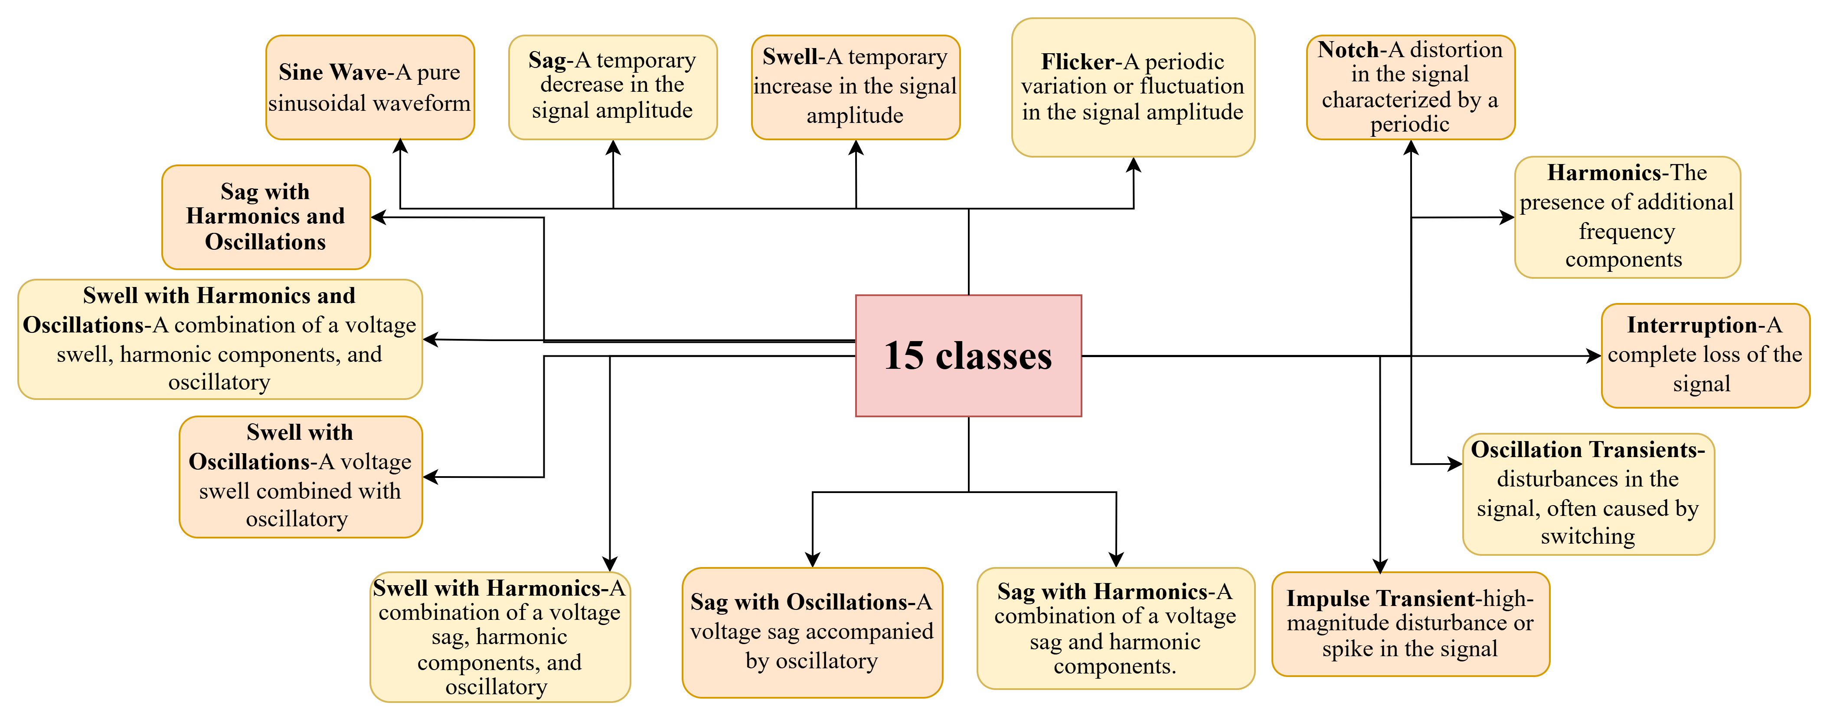
Methodology

Slide 9
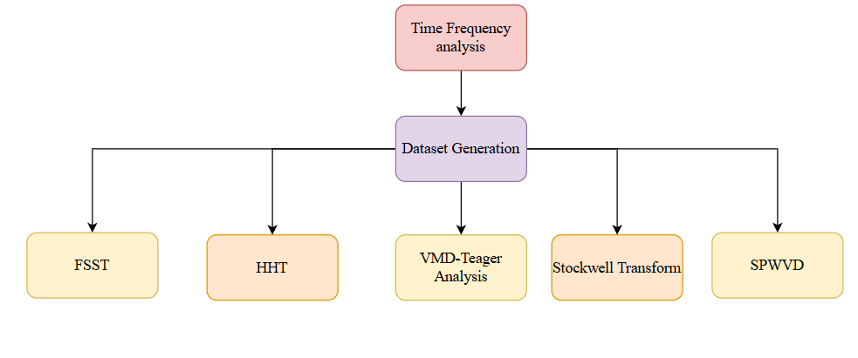
Methodology
Fig 2 Methods of approach

Slide 10
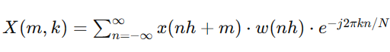
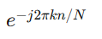
Fourier Synchro-Squeezing Transform
STFT method was used for time-frequency analysis of signals.
It represents how the frequency content of a signal changes overtime by computing the Fourier Transform of small sections of the signal.
STFT of a signal :
X(m,k) - is the STFT at time index m and frequency index k.
X(n) is the input signal.
w(n) is the window function, which is usually applied to localize the analysis in time.
h-determines overlap between two consecutive windows
n-length of each window
Eq (1)
Complex exponential term that performs FT for each window

Slide 11
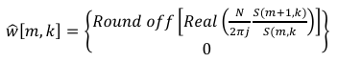
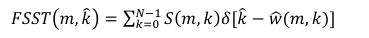
Fourier Synchro-Squeezing Transform​
The matrix will be squeezed, and the energy can be localized further by non-linear mapping.
Synchro squeezing may require the instantaneous frequency.
If in case S(m,k) that is STFT function=0,
Eq-(2)
Eq-(3)​

Slide 12
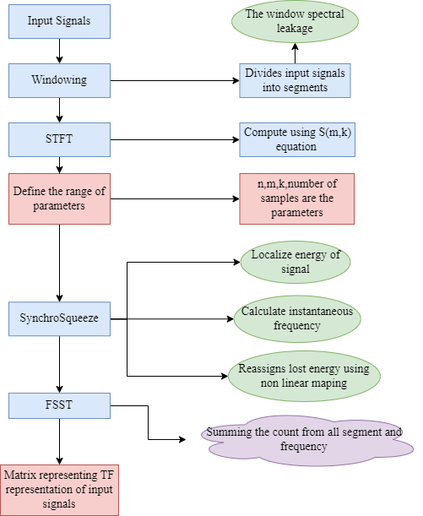
FSST
Fig 3 Flowchart of FSST

Slide 13
Fourier Synchro-Squeezing Transform
The final output:
Time-frequency representation of the signal, (the energy is localized in both time and frequency domains.)
Non-stationary signals with time-varying frequency components.
By incorporating the CWT as a preprocessing step:
FSST enhances wavelet-based time-frequency analysis for better characterization of non-stationary signals and more informative representations.

Slide 14
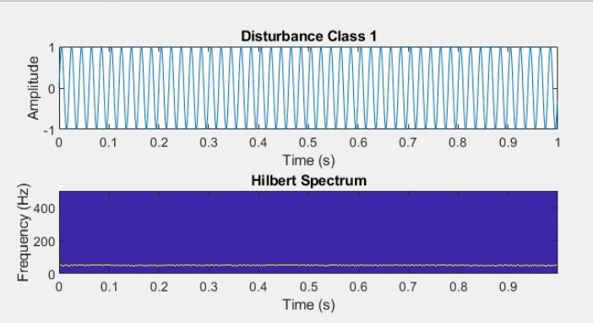
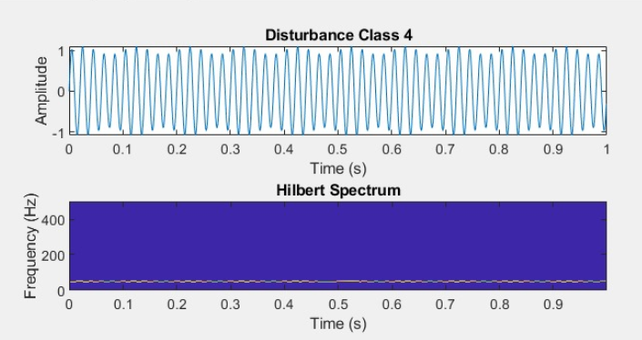
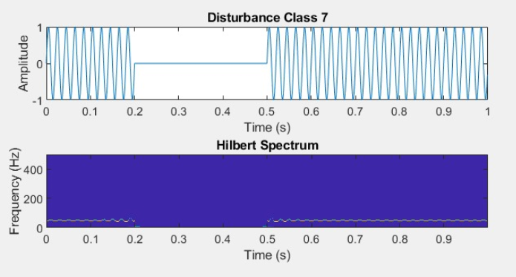
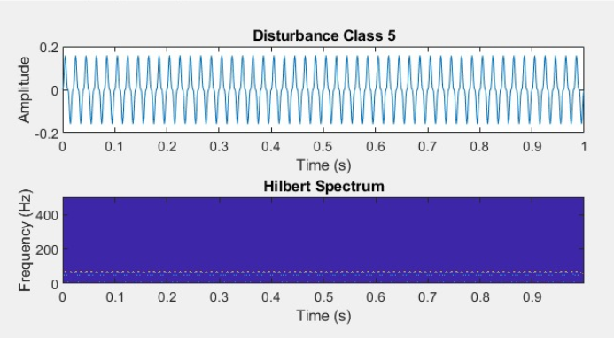
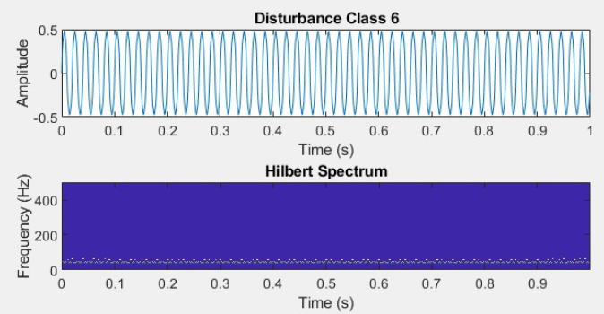
Results : HHT Method
PQD Class 1:SineWave​
PQD Class 4: Flicker​
PQD Class 5:Notch​
PQD Class 6:Harmonics​
PQD Class 7:Interruption​
Fig 4 HHT output

Slide 15
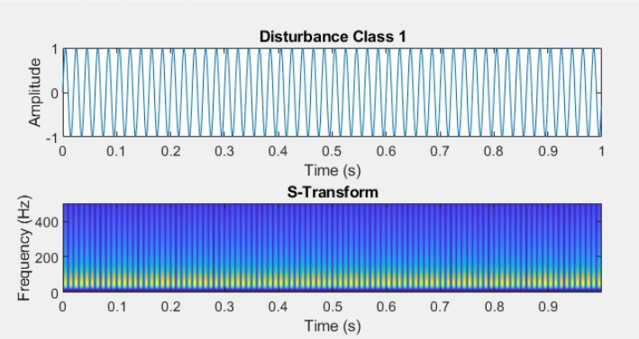
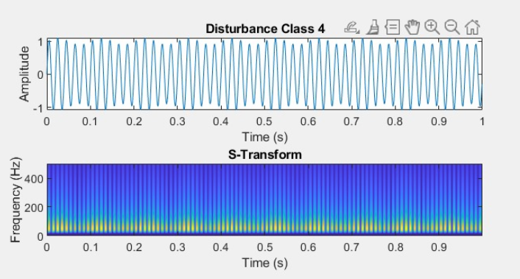
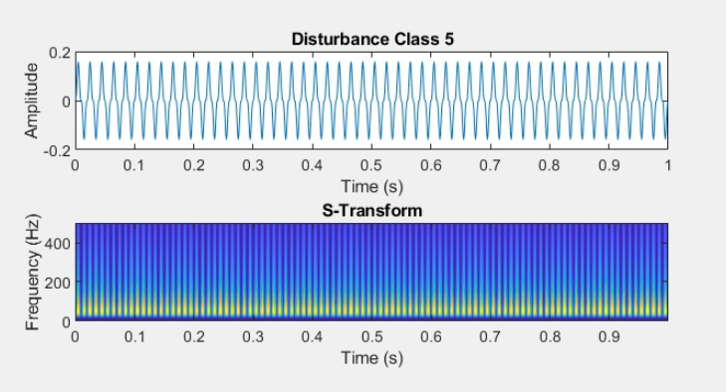
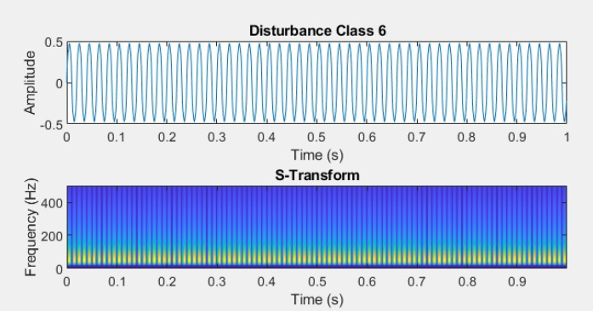
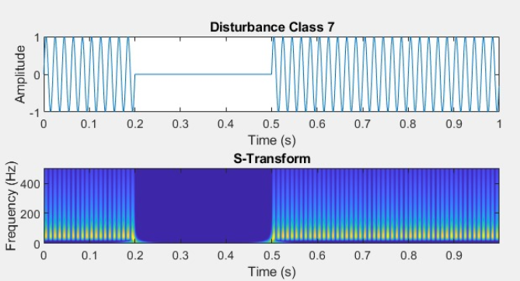
Results: ST Method
PQD Class 1:SineWave
PQD Class 4: Flicker
PQD Class 5:Notch
PQD Class 6:Harmonics
PQD Class 7:Interruption
Fig 5 ST output

Slide 16
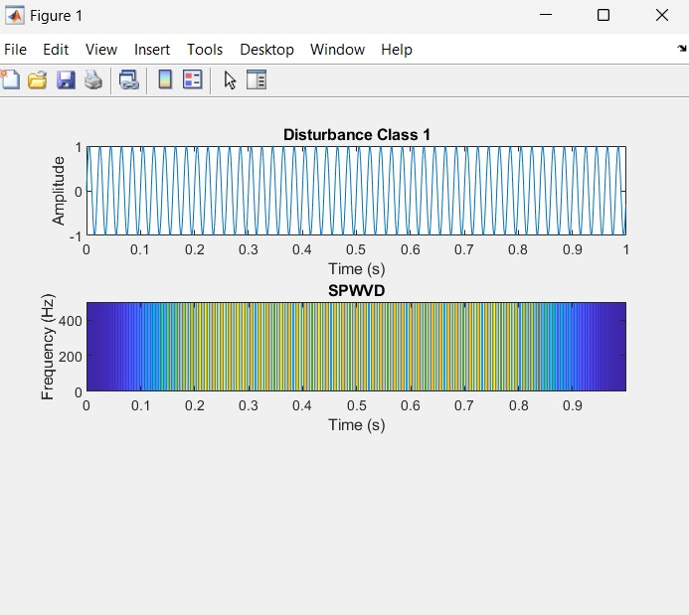
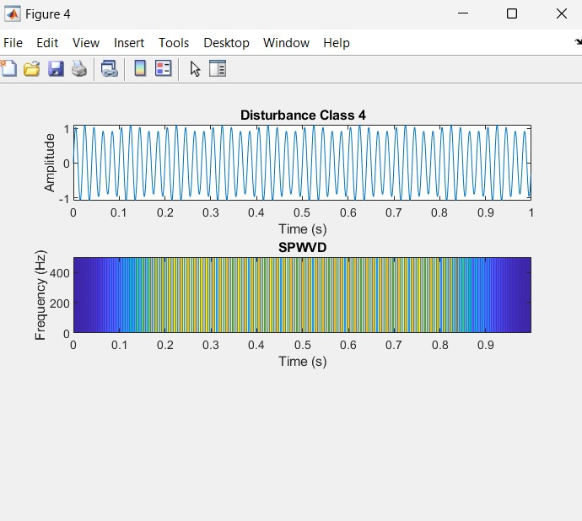
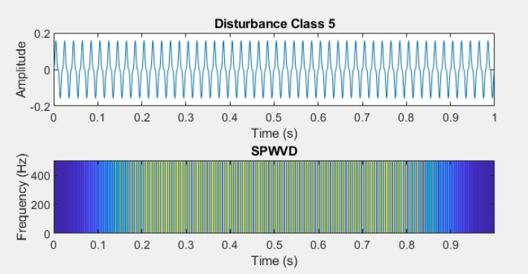
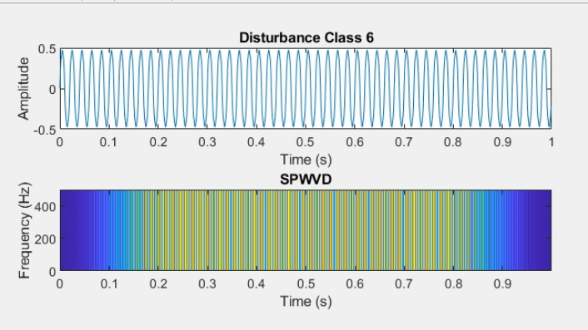
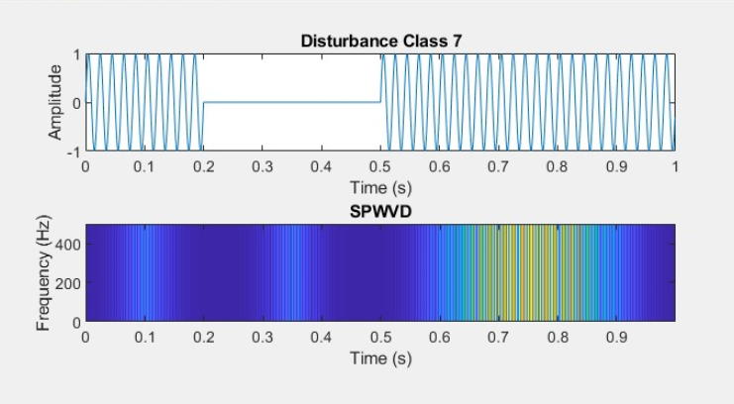
Results: SPWVD
PQD Class 1:SineWave​
PQD Class 4: Flicker​
PQD Class 5:Notch​
PQD Class 6:Harmonics​
PQD Class 7:Interruption​
Fig 6 SPWVD output

Slide 17
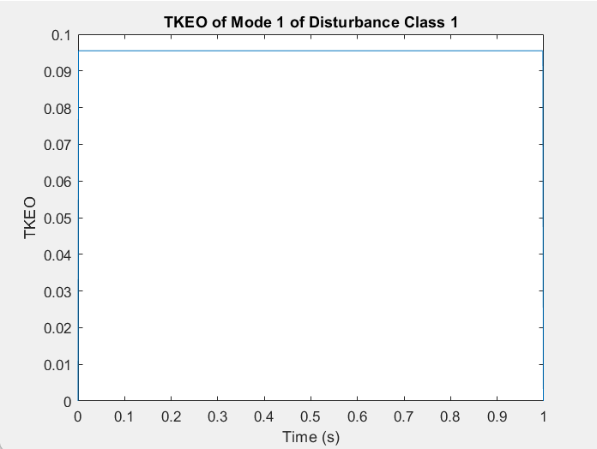
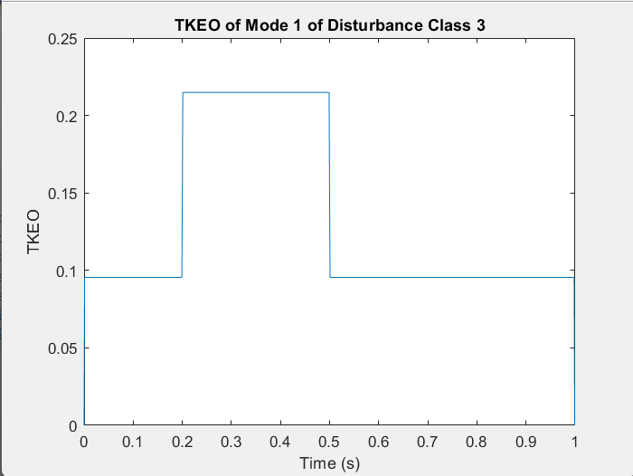
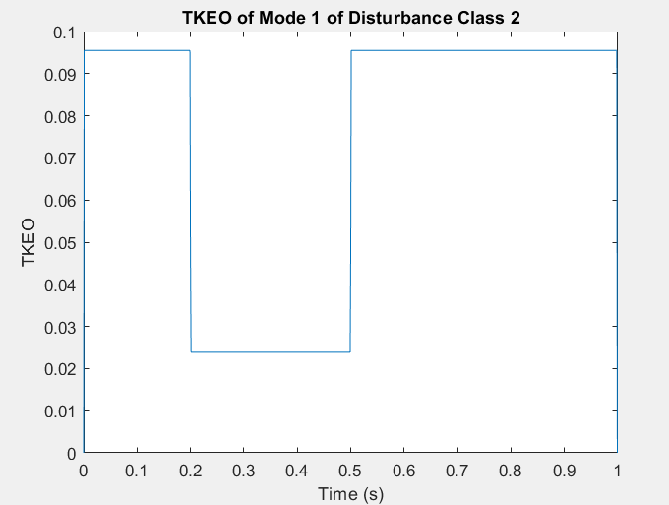
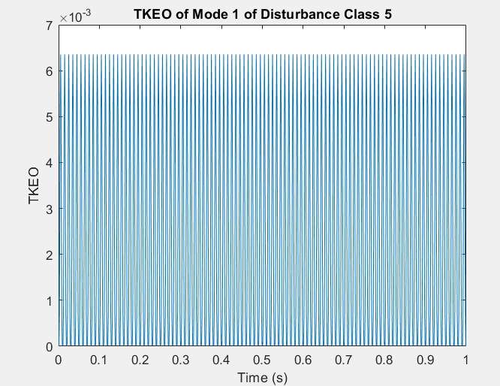
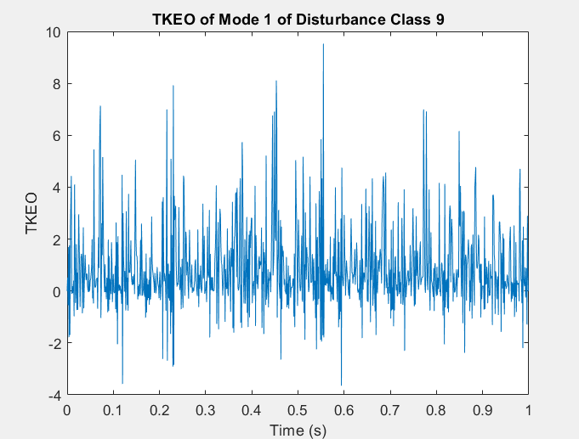
Results: VMD_teager:
PQD Class 1:SineWave​
PQD Class 2: Sag
PQD Class 3:Swell
PQD Class 5:Notch
PQD Class 9:Implulse Transient
Fig 7 VMD_teager1 output

Slide 18
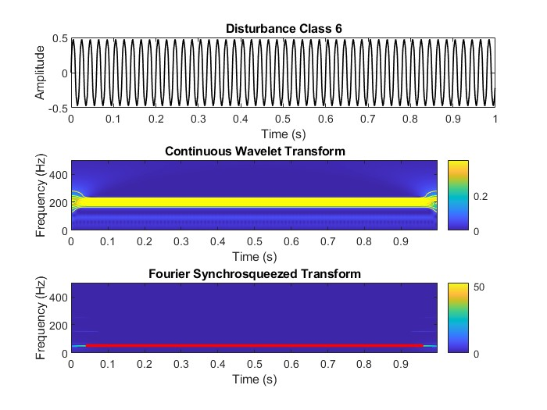

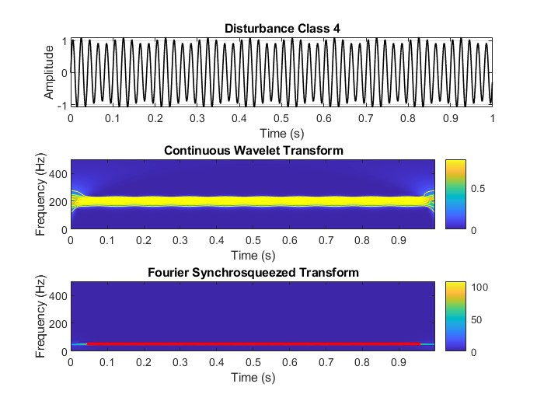
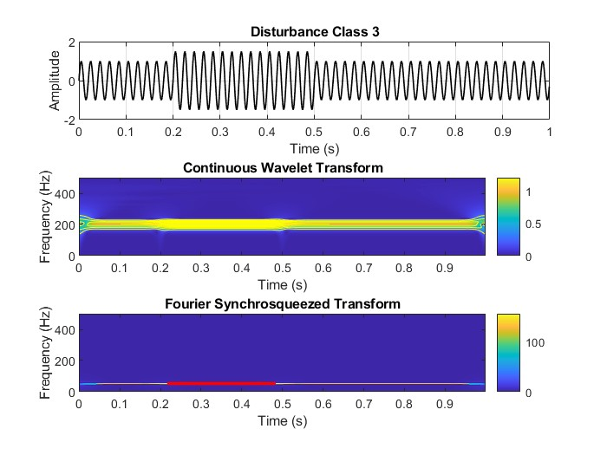
Results: FSST
PQD Class 3:Swell
PQD Class 4: Flicker​
PQD Class 5:Notch​
PQD Class 6:Harmonics​
Fig 8 FSST output

Slide 19
Observation of Results :
FSST: Provides a clear and sharp localization of the event in both time and frequency domains, allowing precise identification of amplitude variations.
ST: Offers good time-frequency resolution but lacks the sharpness of FSST, resulting in less precise localization of the swell event.
HHT: Shows detailed time-frequency information but can be less consistent in capturing abrupt changes due to mode mixing.
SPWVD: Provides reduced cross-term interference but may suffer from reduced time frequency resolution , making the interpretation less straightforward.
VMD-TKEO: Effectively decomposes the signal into modes and highlights the swell event, but the time-frequency representation is less refined compared to FSST.

Slide 20
Comparison:
Sno. | Comparison | FSST | HHT | ST | SPWVD | VMD and Teager combination
1. | Methodology | Reassigns energy by Windowed Fourier Transform. | It decomposes signal into IMF using EMD. Then applies instantaneous frequency through HST | Multiplying CWT coefficients by a phase factor. | It applies smoothing function to reduce interference from cross-term. | VMD decomposes a signal into several IMFs. TKEO analyzes instantaneous energy.
2. | Pros | More localized representation of signal components. Adaptive frequency tracking. | Good for instant phase and frequency calculation of signal. | It can adapt its resolution to the local characteristic of the signal. It fills in data that is empty for a clear view. | It accurately captures time-frequency structures in short-duration, rapidly changing signals. | Adaptive, band-limited decomposition High sensitivity to signal energy changes.
Table 2.1

Slide 21
Comparison:
Sno. | Comparison | FSST | HHT | ST | SPWVD | VMD and Teager combination
3. | Cons | Computationally intensive. Sensitive to the choice of parameters. | Implementation is little complex. Lacks theoretical support Distortions signal while using EMD | Not suitable for Harmonics | Careful selection of parameters is required | It requires parameter tuning and can be computationally intensive.
4. | Time-Frequency Resolution | FSST offers high time-frequency resolution | HHT provides high time-frequency resolution | ST offers improved time-frequency resolution. | SPWVD provides high-resolution time-frequency representation | Enables precise detection of multi-resolution components and instantaneous energy changes.
Table 2.2

Slide 22
Comparison:
Sno. | Comparison | FSST | HHT | ST | SPWVD | VMD and Teager combination
5. | Signal Characteristics | Its input consists of time-domain signals The output shows the energy distribution of signal over time and frequency. | Input signal is non-stationary, non-linear Can handle complex signals also | Input Signal is non- stationary, non- linear Can handle complex signals also | Effective for capturing transient events and oscillatory behavior | It handles non-stationary signals. And captures different frequency components as separate modes.
6. | Computational Complexity | Depends on the signal length and the chosen window size. It typically involves multiple Fourier transforms and convolution operations. | Determined by EMD and HT Depend on number of extremes and shifts Complexity can be reduced to O(log(n)) by using FFT or DCT | Characterized by number of operations required to compute TFR for input signal | Computational complexity increases with the length of the signal. | VMD involves iterative optimization TKEO is computationally simple but can be affected by noise.
Table 2.3

Slide 23
Comparison:
Sno. | Comparison | FSST | HHT | ST | SPWVD | VMD and Teager combination
7. | Robust to noise | Excessive noise can still degrade its performance. | Less sensitive to noise | Resilient to noise and capable of distinguishing signal from noise. | It is sensitive to noise . | It be affected by noise.
8. | Interpretations | Reassigns frequency components to their true instantaneous frequencies for a clearer time-frequency representation. | Decomposes non-linear, non-stationary signals into IMFs using EMD Then extracts instantaneous frequency via the Hilbert Transform. | Combines wavelet and STFT for fixed-resolution time-frequency representation. And reduces cross-term interference in Wigner-Ville distribution. | Captures instantaneous energy and frequency variations for a detailed energy-based time-frequency analysis. | Captures instantaneous energy and frequency variations for detailed time-frequency analysis.
Table 2.4

Slide 24
References
[1] Oberlin, T., Meignen, S. and Perrier, V., 2014, May. The Fourier-based synchrosqueezing transform. In 2014 IEEE international conference on acoustics, speech and signal processing (ICASSP) (pp. 315-319). IEEE.
[2] Sahu, G. and Choubey, A., 2017. Time-Frequency Analysis of Non-Stationary Waveforms in Power-Quality via Synchrosqueezing Transform. International Journal of Applied Engineering Research, 12(13), pp.3714-3718.
[3] Vishwanath, Y.U., Esakkirajan, S., Keerthiveena, B. and Pachori, R.B., 2023. A Generalized Classification Framework for Power Quality Disturbances Based on Synchrosqueezed Wavelet Transform and Convolutional Neural Networks. IEEE Transactions on Instrumentation and Measurement.
[4] Baccigalupi, A. and Liccardo, A., 2016. The Huang Hilbert Transform for evaluating the instantaneous frequency evolution of transient signals in non-linear systems. Measurement, 86, pp.1-13.
[5] Ahrabian, A., Looney, D., Stanković, L. and Mandic, D.P., 2015. Synchrosqueezing-based time-frequency analysis of multivariate data. Signal Processing, 106, pp.331-341.
[6] Rahul, 2020. Review of signal processing techniques and machine learning algorithms for power quality analysis. Advanced Theory and Simulations, 3(10), p.2000118.

